Slide 1
Introduction to Deep Learning Chapter 1: Introduction
Pao-Ann Hsiung
National Chung Cheng University

Slide 2
Contents
Chapter Goals
What is machine/deep learning?
History of neural networks and deep learning
Applications of deep learning
Techniques required
What we learnt?
What to do now?

Slide 3
Chapter Goals -- Introduction
To be knowledgeable about what exactly machine and deep learning is
To be familiar with the history of deep learning,
To be familiar with the applications of deep learning,
To be familiar with the techniques required for deep learning
To learn how to program in the Python programming language

Slide 4
What is machine learning (ML)?
Machine learning is a field of computer science that gives computers the ability to learn without being explicitly programmed
Labeled Data
Machine Learning algorithm
Training
Prediction
Labeled Data
Learned model
Prediction
Methods that can learn from and make predictions on data

Slide 5

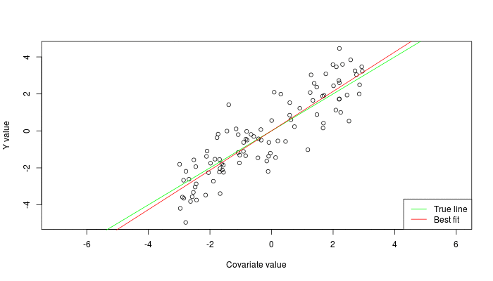

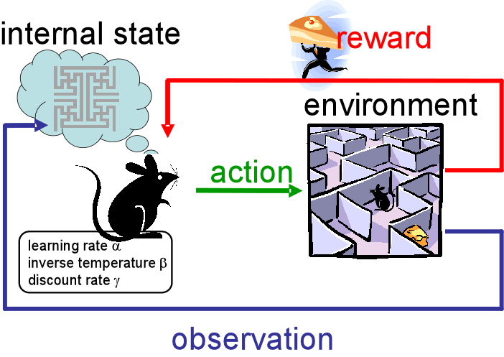
Types of Learning
class A
Supervised: Learning with a labeled training set of data
Example: learn the classification of images based on image labels (dogs/cats, day time, numbers, etc.)
Unsupervised: Discover patterns in unlabeled data
Example: cluster similar documents based on text
Reinforcement learning: learn to act based on feedback/reward
Example: learn to play Go, reward: win or lose
class A
Classification
Regression
Clustering
Sources: http://mbjoseph.github.io/2013/11/27/measure.html
https://becominghuman.ai/the-very-basics-of-reinforcement-learning-154f28a79071

Slide 6
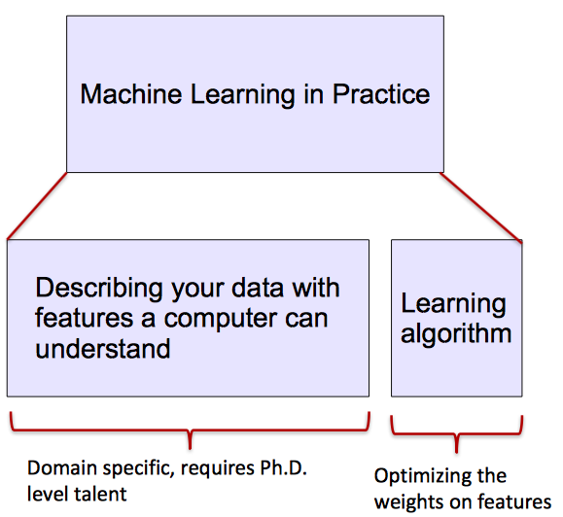
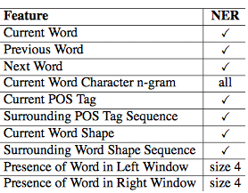
Machine Learning in Practice
Most machine learning methods work well because of human-designed representations and input features
ML becomes just optimizing weights to best make a final prediction
NER: Named Entity Recognition
POS: Part of Speech

Slide 7
Feature Hierarchy
Hierarchy of representations with increasing levels of abstraction
Image recognition
Pixel ➔ edge ➔ texton ➔ motif ➔ part ➔ object
Text
Character ➔ word ➔ word group ➔ clause ➔ sentence ➔ story
Speech
Sample ➔ spectral band ➔ sound ➔ … ➔ phone ➔ phoneme ➔ word

Slide 8

What is Deep Learning (DL) ?
A sub-field of machine learning for learning representations of data.
Exceptionally effective at learning patterns.
Deep learning algorithms attempt to learn (multiple levels of) representation by using a hierarchy of multiple layers
If you provide the system tons of information, it begins to understand it and respond in useful ways.
https://www.xenonstack.com/blog/static/public/uploads/media/machine-learning-vs-deep-learning.png

Slide 9
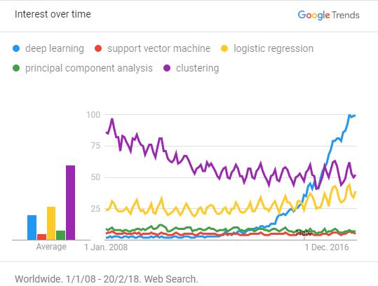
Why is DL useful?
Manually designed features are often over-specified, incomplete and take a long time to design and validate
Learned Features are easy to adapt, fast to learn
Deep learning provides a very flexible, (almost?) universal, learnable framework for representing world, visual and linguistic information.
Can learn in both unsupervised and supervised ways
Effective end-to-end joint system learning
Utilize large amounts of training data
Around 2010, DL started to outperform other ML techniques,
first in speech and vision, then in Natural Language Processing (NLP)

Slide 10
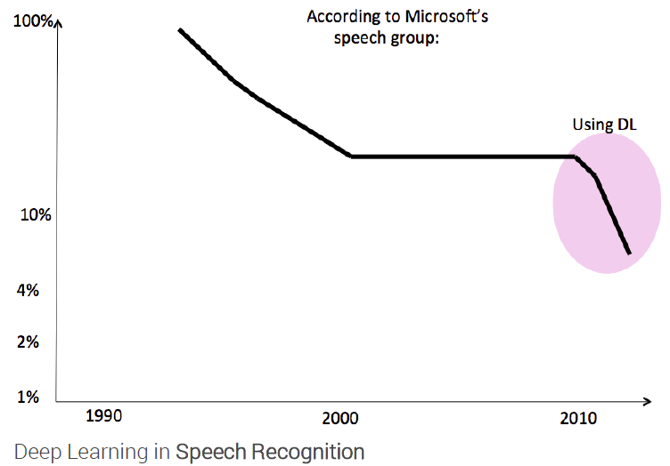
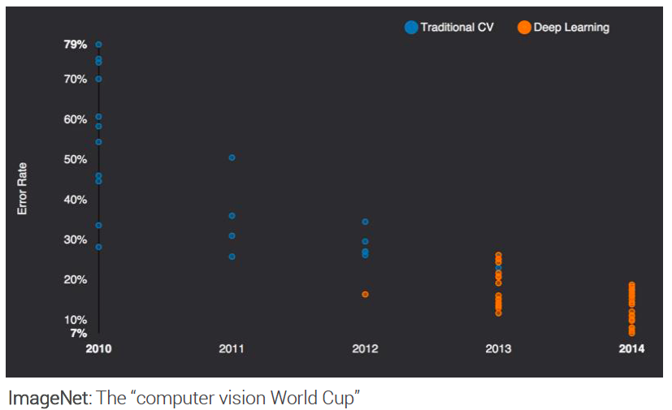
State of the art in …
Several big improvements in recent years in NLP
Machine Translation
Sentiment Analysis
Dialogue Agents
Question Answering
Text Classification …
Leverage different levels of representation
words & characters
syntax & semantics

Slide 11
History of neural networks & deep learning
1958~1969 (Golden Era)
Perceptrons
Rosenblatt (1958), Minsky & Papert (1969)
1981~1998 (AI Summer)
Backpropagation, LSTM, OCR
Rumelhart, Hinton, Williams, Hochreiter, Schmidhuber, LeCun, Bottou, Bengio, Haffner
2006~now (Thaw of AI Winter)
Deep Learning, Imagenet, Alexnet, GoogLeNet etc.
Hinton, Osindero, Teh, Deng, LeCun, Bottou, Bengio, Haffner
1970~1980 (1st AI Winter)
Minsky & Papert showed XOR cannot be solved by Perceptrons (1969)
AI Dreams shattered
Backpropagation: Linnainmaa, Werbos
1999~2005 (2nd AI Winter)
Kernel Machines (SVM, etc.) became popular
NN could not improve beyond few layers

Slide 12
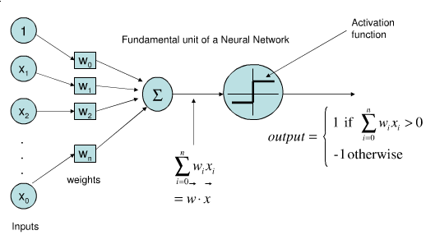
1958~1969: Birth of AI and Golden Era -- Perceptrons
Rosenblatt proposed a machine for binary classifications
Main idea
One weight w_{i} per input x_{i}
Multiply weights with respective inputs and add bias w₀
If result is larger than threshold δ, return 1, otherwise 0.
δ

Slide 13
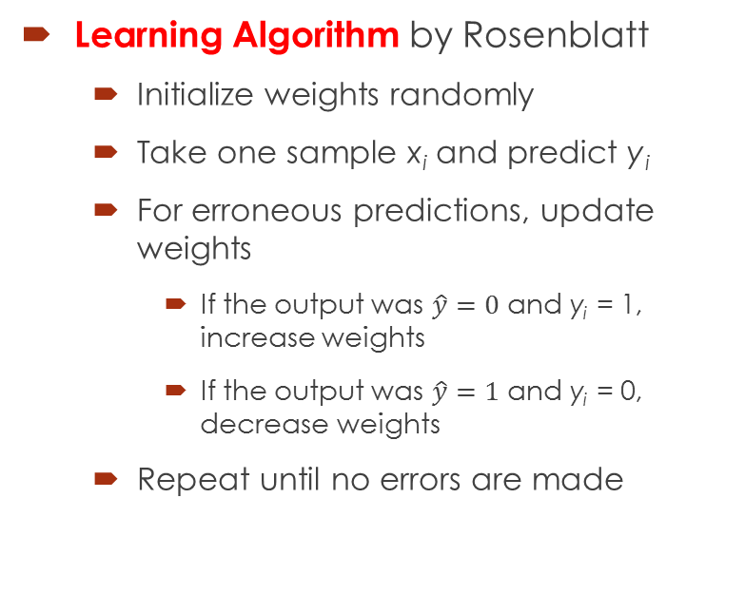
Training a perceptron
Learning Algorithm by Rosenblatt
Initialize weights randomly
Take one sample x_{i} and predict y_{i}
For erroneous predictions, update weights
If the output was $\hat{y}=0$ and y_{i} = 1, increase weights
If the output was $\hat{y}=1$ and y_{i} = 0, decrease weights
Repeat until no errors are made
Video (18’54”): https://youtu.be/OVHc-7GYRo4

Slide 14
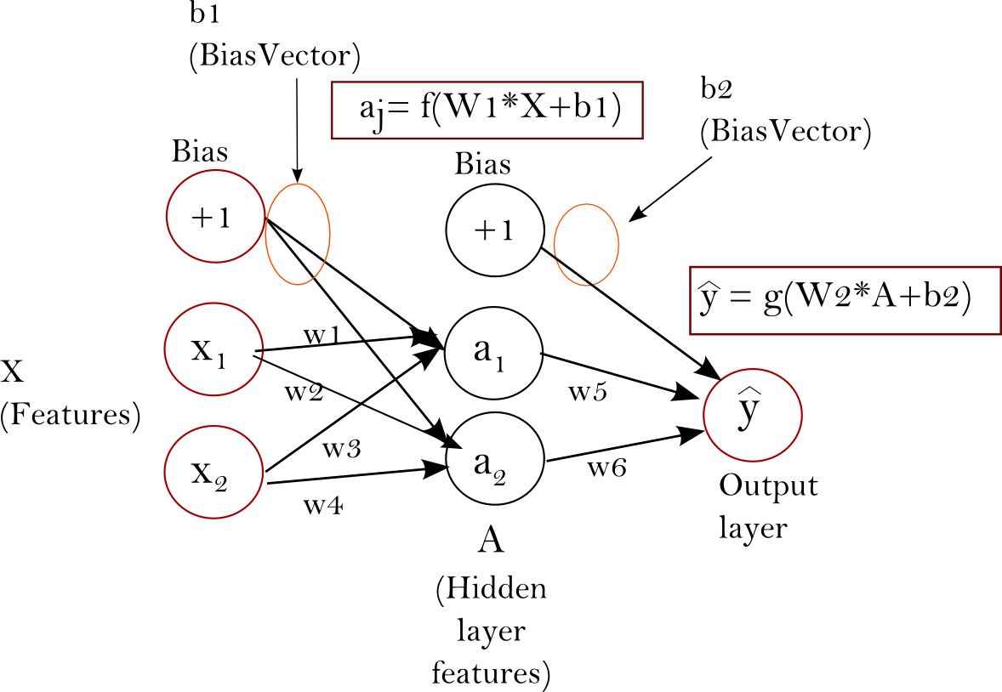
Multi-Layer Perceptron
One perceptron = one decision
Question: What about multiple decisions?
Eg. Digit classification
Answer: Neural Network (NN) or Multi-Layer Perceptron (MLP)
Stack multiple perceptrons (neurons) into a single layer
Connect two or more layers by feeding output of one layer as input to the next layer

Slide 15
1970~1980: 1st AI Winter
XOR cannot be solved by Perceptron (Minsky)
Perceptron training method cannot be applied to Neural Networks
Funding slushed, Neural Networks were damned
AI WINTER!!!
Dreams shattered!
Some significant results
Backpropagation: training method for NN (1970, 1974)

Slide 16
1981~1998: AI Summer
XOR can be solved using Neural Networks (Multi-Layer Perceptron)
Backpropagation (1986)
Complicated NN architectures allowed
Temporal behavior, language, sequences could be learnt using “Recurrent Long-Short Term Memory (LSTM) Networks” in 1997
Digit recognition in cheques (OCR) solved using Convolutional Neural Network (CNN) in 1998

Slide 17
1999~2005: 2nd AI Winter
Kernel Machines (e.g. Support Vector Machines (SVM), etc.) became popular
Achieved similar accuracies
Included much fewer heuristics
Nice proofs on generalization
Neural networks could not improve beyond a few layers
Lack of processing power (No GPUs)
Lack of data (No big, annotated datasets)
Overfitting (Models could not generalize)
Vanishing gradients (0.1*0.1*0.1*….*0.1 = 0.000000000001, too small for learning)
AI community turned away from Neural Networks

Slide 18
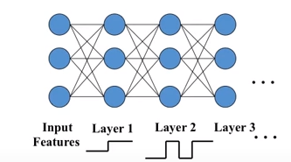
2006~now: Thaw of AI Winter
Questions:
Are 1-2 hidden layers the best NN can do?
Or, is it the learning algorithm not really mature?
Deep Learning (2006, Hinton, Osindero, Teh)
Layer-by-layer training
Per-layer trained parameters initialize further training using contrastive divergence
Training Layer

Slide 19
Deep Learning is here …
ImageNet dataset (Deng et al, 2009)
Collected images for each term of Wordnet (100,000 classes)
Tree of concepts organized hierarchically
“Ambulance”, “Dalmatian dog”, “Egyptian cat”, …
Imagenet Large Scale Visual Recognition Challenge (ILSVRC)
1 million images
1,000 classes
Top-5 and top-1 error measured
Errors reduced drastically in the past 8 years (2010~2017): 28.2% ➔ 2.3%

Slide 20
ImageNet Large Scale Visual Recognition Challenge (ILSVRC)
152 layers
22 layers
Shallow
8 layers
AlexNet
VGG,
GoogLeNet
ResNet
SENet

Slide 21
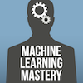
Some FUN now …
The Neural Network ZOO
Graphical notations for all kinds of neural networks
http://www.asimovinstitute.org/neural-network-zoo/
A Neural Network Playground
An online interactive way to play with different network architectures
http://playground.tensorflow.org
8 Inspirational Applications of Deep Learning
Very interesting applications of deep learning
http://machinelearningmastery.com/inspirational-applications-deep-learning/

Slide 22
(1/8) Automatic Colorization of B&W Images
Large Convolutional Neural Networks (CNN)
Website
http://richzhang.github.io/colorization/
Video (5 s)
http://whattogive.com/videoColourization/

Slide 23
(2/8) Automatically Adding Sounds
Two types of NN
Large CNN for images
Large Long Short-Term Memory (LSTM) Recurrent Neural Networks (RNN) for sound
News
http://news.mit.edu/2016/artificial-intelligence-produces-realistic-sounds-0613
Visually Indicated Sounds (MIT)
http://vis.csail.mit.edu/
Video (2.54 s)
https://youtu.be/0FW99AQmMc8

Slide 24
(3/8) Automatic Machine Translation
Automatic Translation of Text
Large Long Short-Term Memory (LSTM) Recurrent Neural Networks
Automatic Translation of Images
CNN + LSTM RNN

Slide 25
How Google Translate squeezes deep learning onto a phone!
Demonstration

Slide 26
(4/8) Object Classification & Detection in Photographs
Large deep CNN
Paper on ImageNet Classification
http://www.cs.toronto.edu/~fritz/absps/imagenet.pdf

Slide 27
ConvNetJS: CIFAR-10 Demo
ConvNetJS: CIFAR-10 Demo
http://cs.stanford.edu/people/karpathy/convnetjs/demo/cifar10.html
Clarifai: 10,000 images
https://www.clarifai.com/

Slide 28
(5/8) Automatic Handwriting Generation
Usage: used with forensic analysis

Slide 29
Automatic Handwriting Generation DEMO
http://www.cs.toronto.edu/~graves/handwriting.html

Slide 30
(6/8) Automatic Text Generation
Large RNN
Code on Github
https://github.com/karpathy/char-rnn
Paul Graham generator
Shakespeare
Wikipedia
Algebraic Geometry (LaTeX)
Linux source code
Generating Baby Names

Slide 31
Automatic Music Synthesis
Using large RNN
Authors comments:
This track was made using a RNN. Fed 500 mb guitar tabs in ASCII. It writes the tabs out in ASCII, I imported into GuitarPro, recorded the output, imported that into FL Studio, added some filters and a drum loop and got this. The notes and rhythms themselves are totally unedited.
Music (5:20):
https://soundcloud.com/optometrist-prime/recurrence-music-written-by-a-recurrent-neural-network

Slide 32
(7/8) Automatic Image Caption Generation
Large CNN → Object Detection
Large LSTM RNN → Caption Text Generation
Deep Visual-Semantic Alignments for Generating Image Descriptions
http://cs.stanford.edu/people/karpathy/deepimagesent/

Slide 33
Automatic Image Captioning
Demo
http://cs.stanford.edu/people/karpathy/deepimagesent/rankingdemo/

Slide 34
(8/8) Automatic Game Playing
Vision
Decision Making
Etc.

Slide 35
Game Playing Demo
https://youtu.be/TmPfTpjtdgg

Slide 36
AlphaGo
AlphaGo by Google Deepmind Team
https://deepmind.com/research/alphago
News:
AlphaGo program played against Lee Sedol (18 times world champion) in a tournament that took a week to play, five matches between March 9-15, 2016 at the Four Seasons Hotel in Seoul, South Korea.
It became the first program to beat a professional Go player, and in doing so showed an advancement of artificial intelligence that took the world by surprise.
Press Conference
https://youtu.be/yCALyQRN3hw?t=20728

Slide 37
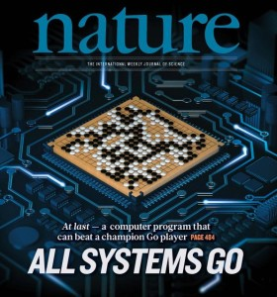
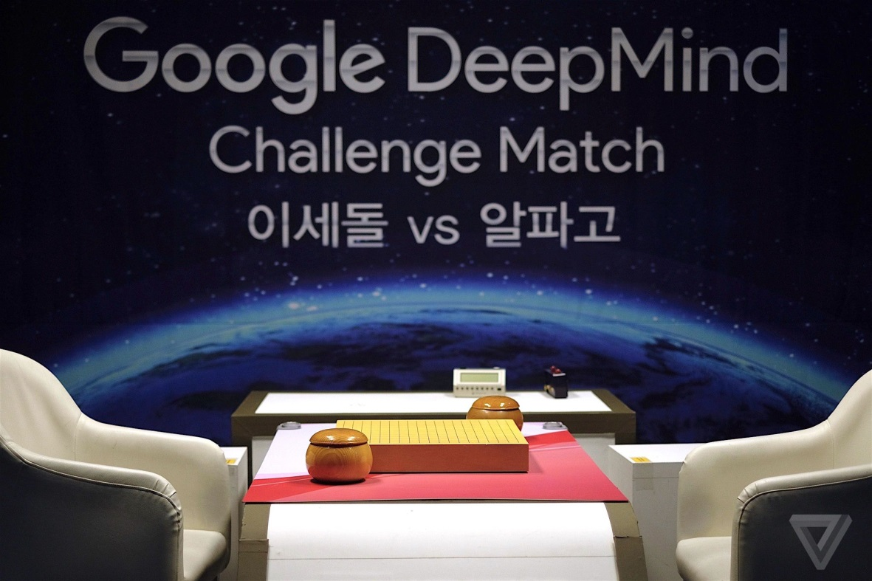
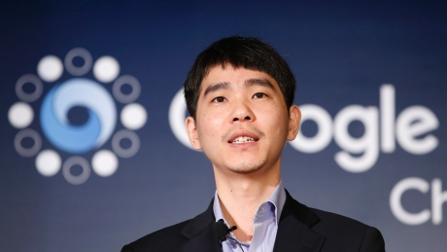
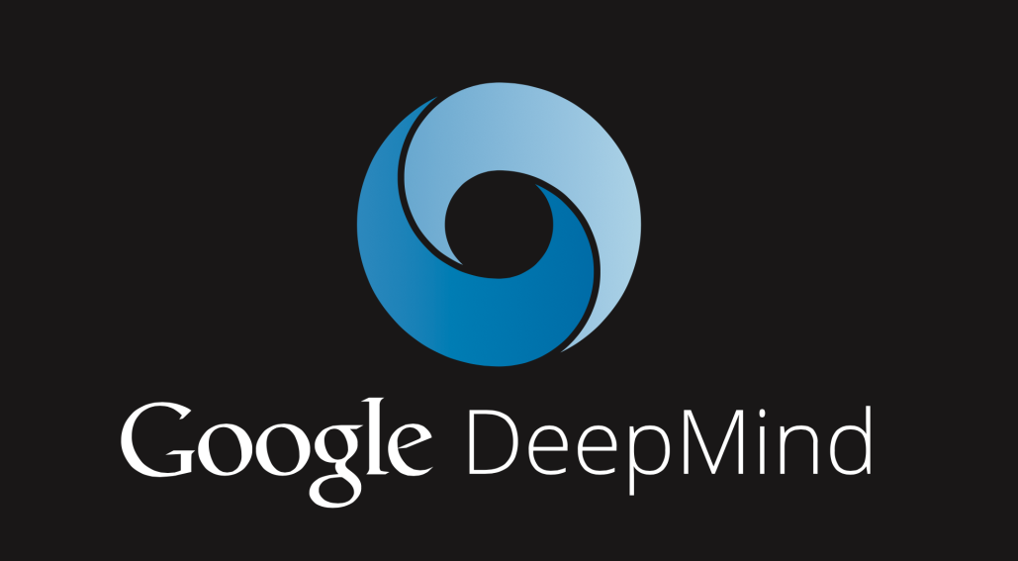
AlphaGo in the news!

Slide 38
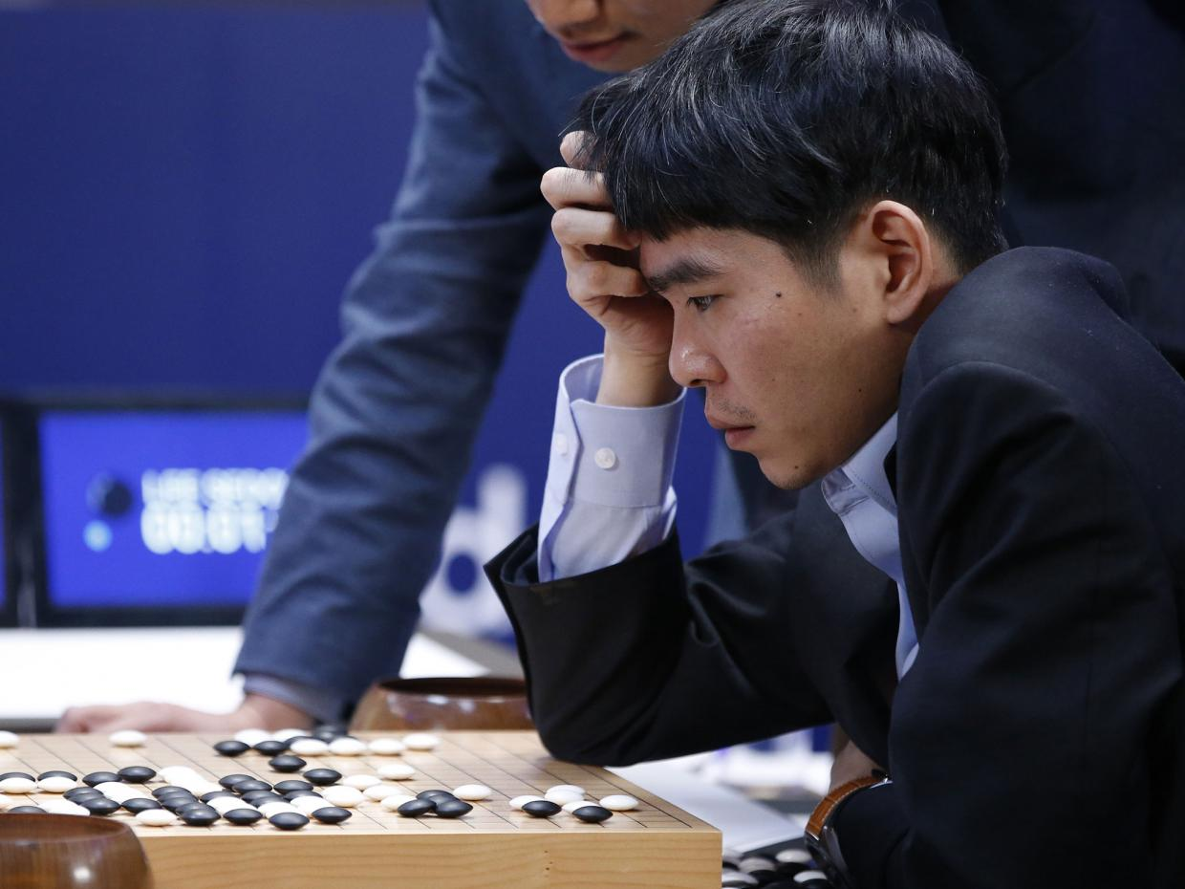
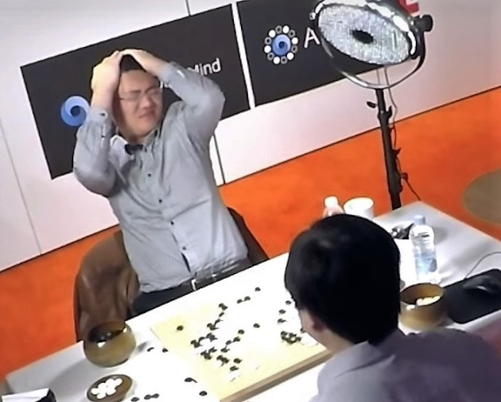
AlphaGo
4:1
5:0

Slide 39
Alpha Go
Used general purpose algorithms
Not a set of handcraft rules
Very different from Deep Blue (expert system)
Modular system combining planning and pattern recognition
Think like human
Reinforcement and deep learning

Slide 40
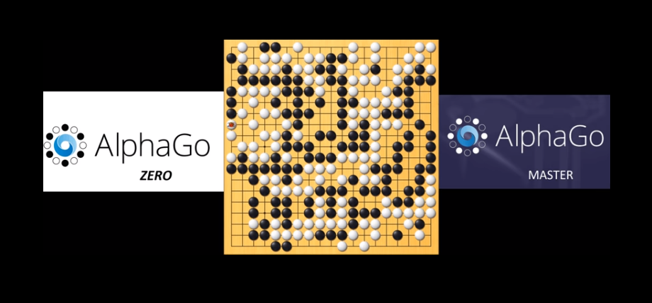
AlphaGo Zero
Alpha Go
Learn from large amounts of HUMAN PLAYS
Defeated the World Champion Lee Sedol from Korea
AlphaGo Zero
Learning by itself (No human data)!
Defeated all previous versions of Alpha Go
Used less computation that previous versions of Alpha Go
Defeated the version of Alpha Go that defeated the World Champion (result: 100:1)
About: https://www.youtube.com/watch?v=tXlM99xPQC8
Nature Paper: https://www.nature.com/articles/nature24270
AlphaGo Zero vs. AlphaGo Master Game1: https://youtu.be/-Wh4CfsWDyM
AlphaGo Zero vs. AlphaGo Master Game2: https://youtu.be/xOVwmCOX7S4

Slide 41
Alpha Zero
Not only Go!
Also Chess and Shogi
Self-play using 5,000 first-generation TPUs to generate games, 64 second-generation TPUs to train the NN, all in parallel.
Differences between AlphaGo Zero
Alpha Zero has hard-coded rules for setting search hyperparameters
NN is updated continually
Did not take advantage of symmetry (AlphaGo Zero used symmetry in Go)
Chess can end in a draw, AlphaZero takes draws into account.

Slide 42
Techniques required for DL
Python Programming Language
Deep Learning Frameworks
Calculus

Slide 43
Python programming language
Why Python?
More Information on Python
Installing Python
Jupyter Notebooks
Examples of running Python
Running Python in Jupyter Notebooks

Slide 44
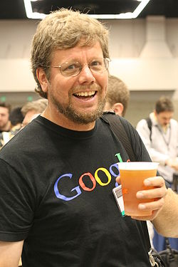
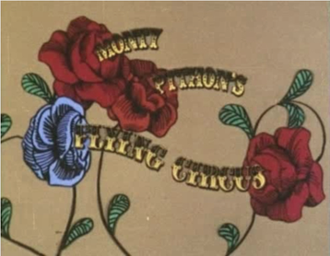
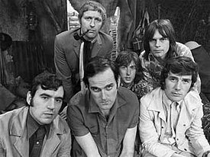
Python programming language
Conceived in late 1980’s
Implementation started in December 1989
Creator: Guido van Rossum at CWI in the Netherlands (2005-2012 with Google, now with Dropbox)
As successor to ABC programming language, with exception handling and for Amoeba OS
Python named after BBC TV show Monty Python’s Flying Circus
Guido van Rossum

Slide 45
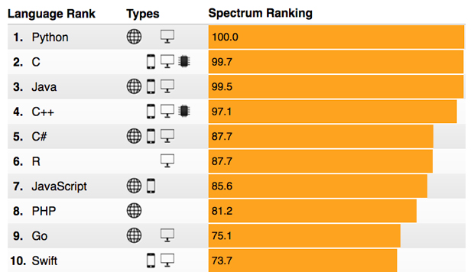
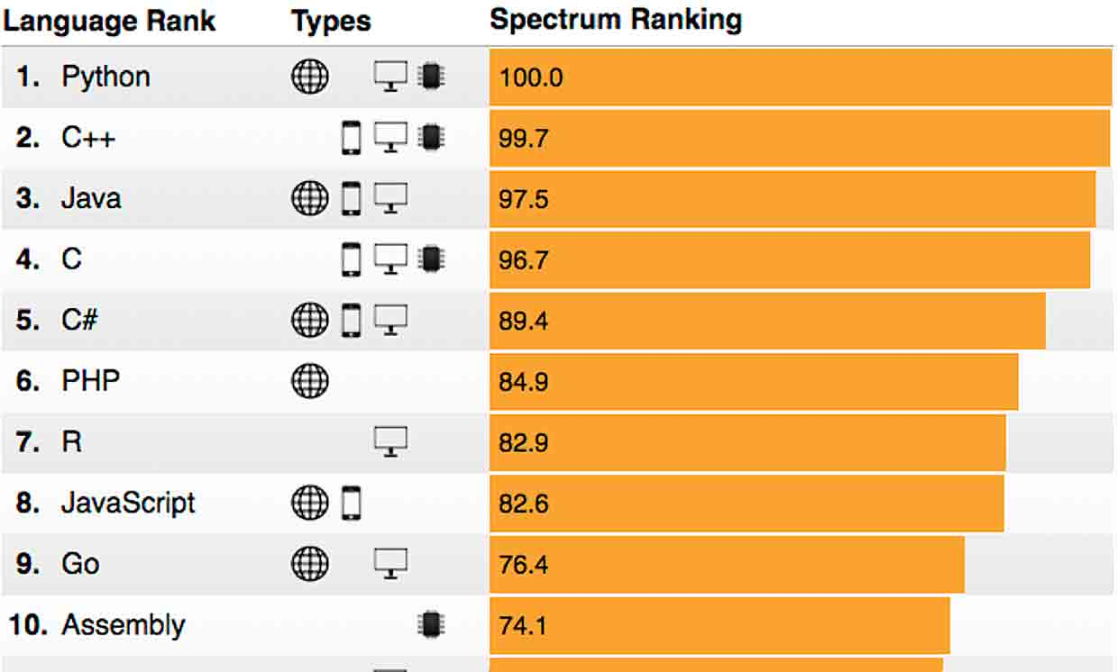
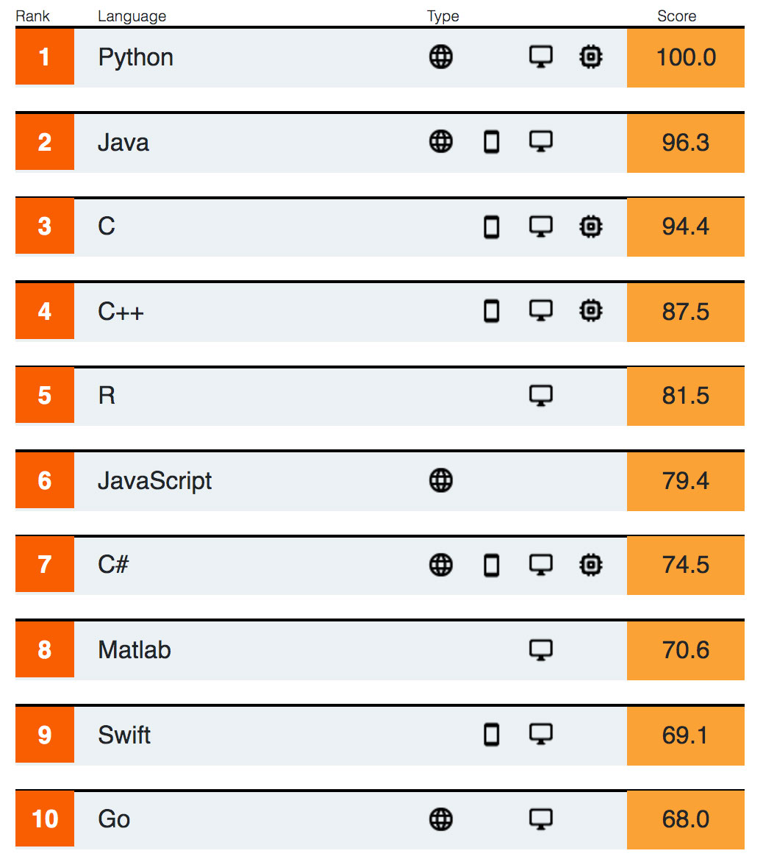
Why Python?
Top Programming Languages by IEEE Spectrum
2017
2018
2019

Slide 46
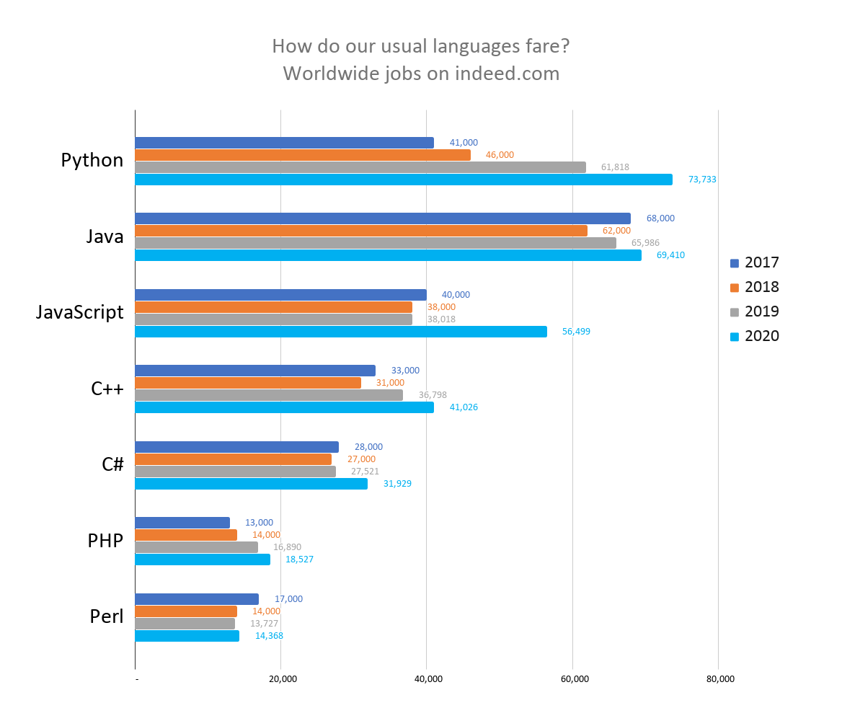
Why Python?
Top Programming Languages by Number of Job Postings by Coding Dojo Blog
https://www.codingdojo.com/blog/top-7-programming-languages-of-2020

Slide 47
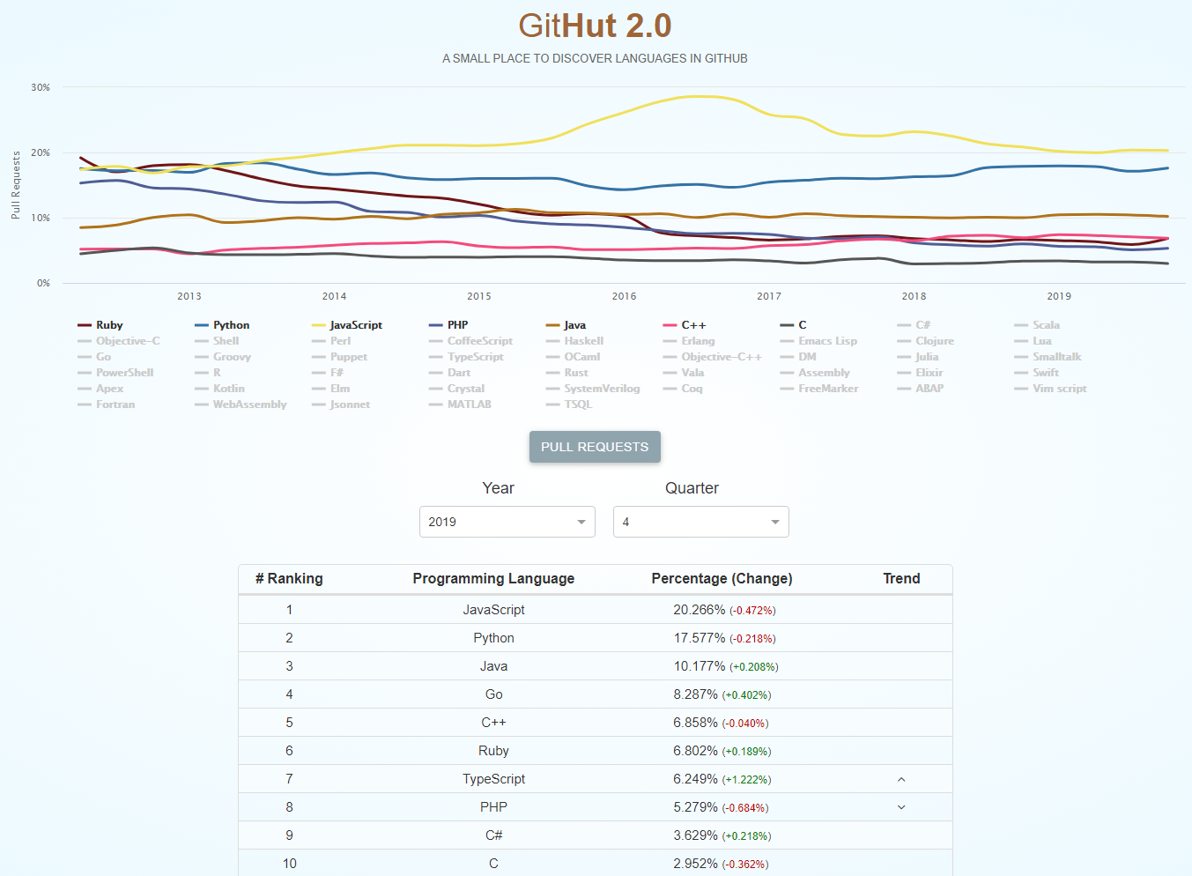
Why Python?
Most
Pull
Requests
On
GitHub
(GitHut 2.0)
Source: https://madnight.github.io/githut/#/pull_requests/2019/4

Slide 48
Why Python?
It is Popular: 1 million Python users
It has NICE features: Object-oriented, open-source, portable
It is POWERFUL: dynamic typing, built-in types and tools, libraries, 3rd party utilities (Numeric, Numpy, SciPy, etc.), automatic memory management
It has W I D E applications
System/GUI programming, Internet Scripting, Component Integration, Database, Gaming, Images, XML, Robot, etc.
Google: uses Python in web search system (Python’s creator employed)
Intel, Cisco, HP, Seagate, Qualcomm, IBM: use Python for hardware testing
YouTube: video sharing services written in Python mostly

Slide 49
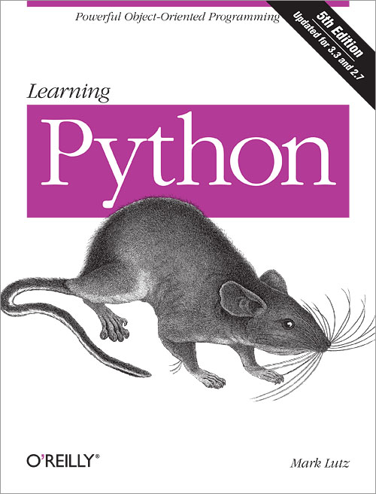

More Information on Python
http://python.org/
Documentation, tutorials, beginners guide, core distribution, etc.
Books
https://wiki.python.org/moin/PythonBooks
http://learning-python.com/about-lp5e.html
Learning Python by Mark Lutz, O’Reilly
Online Python Popular Code Recipes
http://code.activestate.com/recipes/langs/python/ (author site)
http://www.dsf.unica.it/~fiore/LearningPython.pdf (e-book)
Python Crash Course (e-book)
http://ap-n.us/books/Programming/Python%20Crash%20Course.pdf
Videos
https://code.tutsplus.com/courses/introduction-to-python (Learn from SCRATCH)
https://www.tutorialspoint.com/python_online_training/index.asp (Course)

Slide 50
Installing Python
https://www.python.org/downloads/
Mainly TWO versions:
Python2 (currently 2.7.14)
Python3 (currently 3.8.2 as of March13, 2020)
Platforms supported: Windows, Linux/UNIX, Mac OS X, Others
Beginners’ guide
https://wiki.python.org/moin/BeginnersGuide/Programmers
Which IDE to use for Python?
https://docs.google.com/spreadsheets/d/1l3x94P55qoxqYbq5GosWQ7IonZ4vR-4ZyCaImiVmCSk/pubhtml (there are lots of IDE, among which IDLE has a GUI)
In this course, you can use any as long as you can submit your work assignments
For labs, we will use Jupyter Notebooks

Slide 51
Jupyter Notebooks
An open-source web application for interactive data science and scientific computing across 40 programming languages including Python, R, Julia and Scala …
Combines LIVE code and NARRATIVE text, equations, images, video, and visualizations.
Can be shared on GitHub, Dropbox, and Jupyter Notebook Viewer
Leverage big-data tools such as Apache Spark, from Python, R, and Scala. Explore data with pandas, scikit-learn, ggplot2, dplyr, etc.

Slide 52
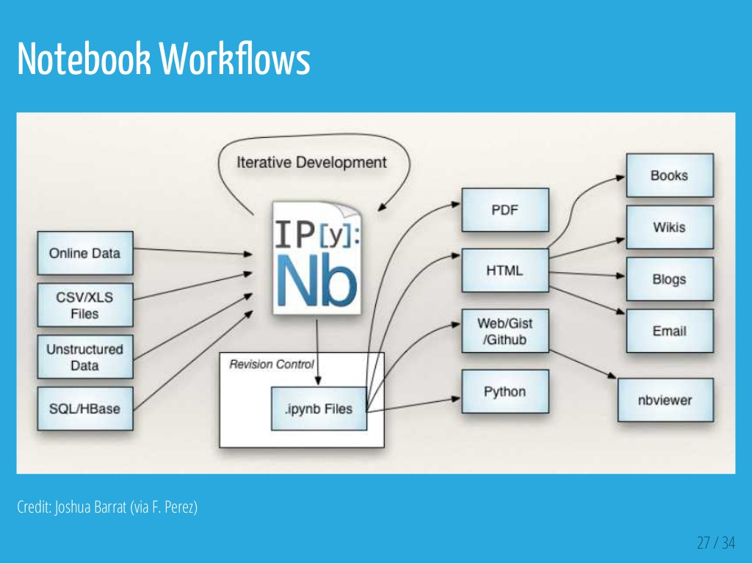
Jupyter Notebooks

Slide 53
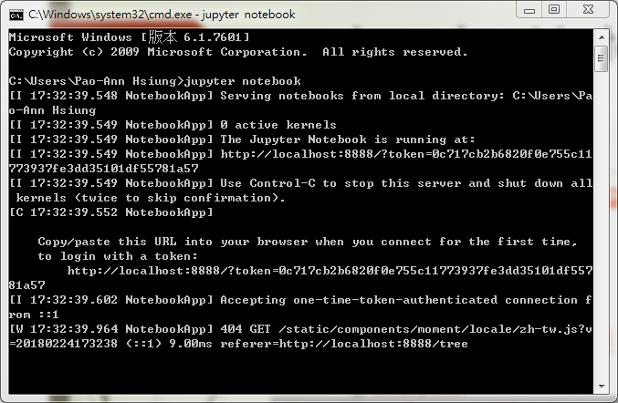
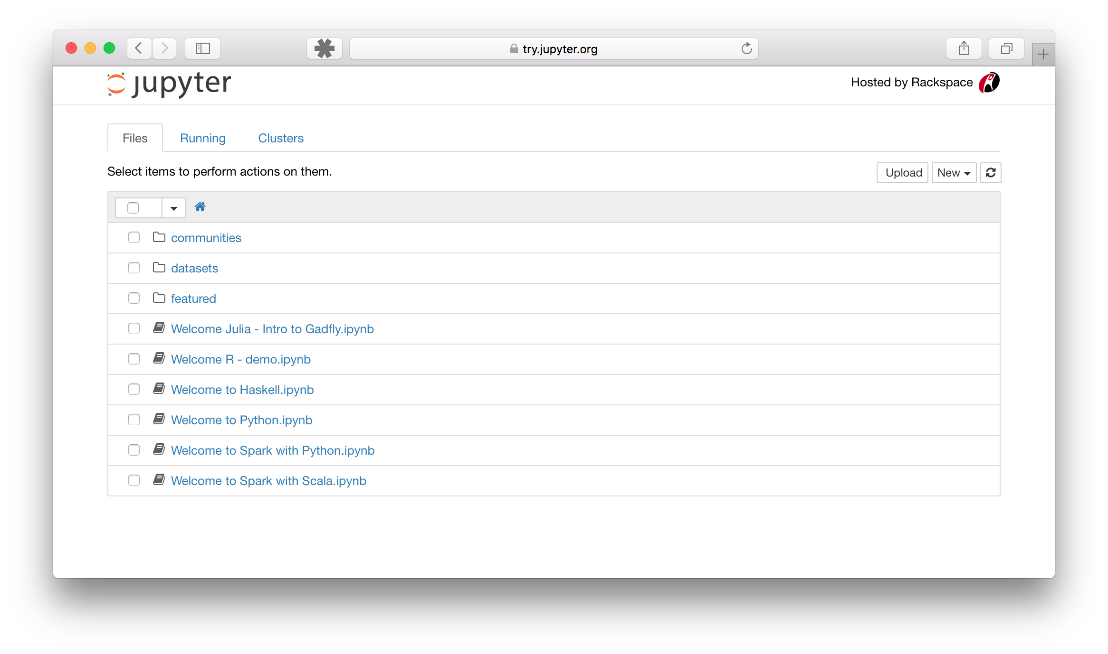
Jupyter Notebooks
Main page: http://jupyter.org
Try it in your browser: https://try.jupyter.org/
Install Jupyter: http://jupyter.org/install.html
Running Jupyter Notebook: https://jupyter.readthedocs.io/en/latest/running.html#running

Slide 54
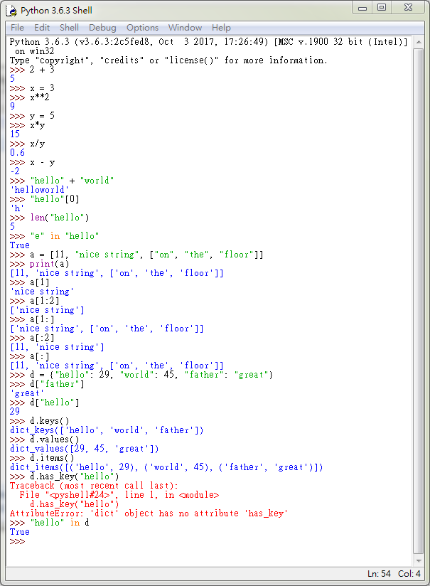
Examples of running Python
Data types
Numbers, Strings, Lists, Dictionaries
List items and slicing
Dictionary keys and values

Slide 55
Running Python in Jupyter Notebooks
A notebook is made up of a number of cells
Each cell can contain Python code, text, images, etc.
You can execute a cell by clicking on it and pressing Shift-Enter.
The output of the cell will be displayed below.
By convention, cells are to be run from top to bottom.
Failing to execute some cells or executing cells out of order can result in errors.
More questions? Check out the following Jupyter Notebook Tutorial:
https://www.datacamp.com/community/tutorials/tutorial-jupyter-notebook

Slide 56
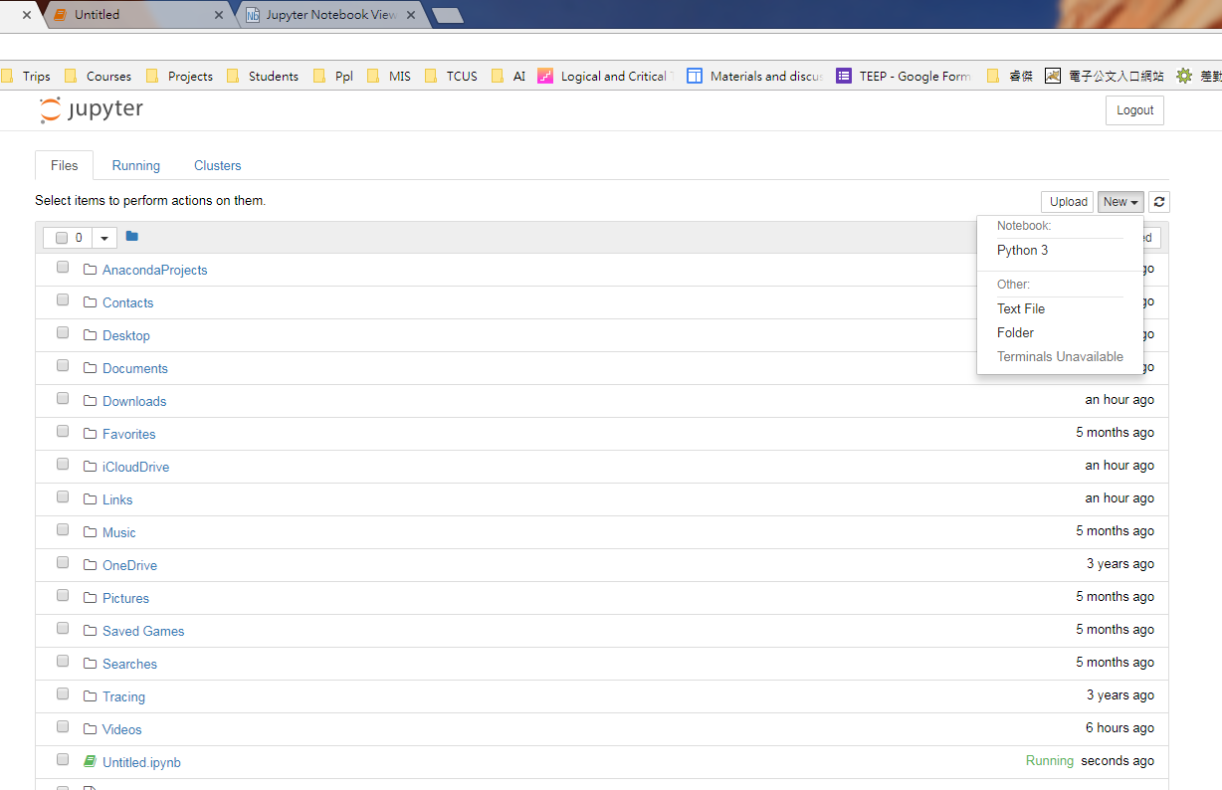
Examples of running Python in Notebook
Several Examples
https://github.com/jakevdp/PythonDataScienceHandbook/tree/master/notebooks

Slide 57
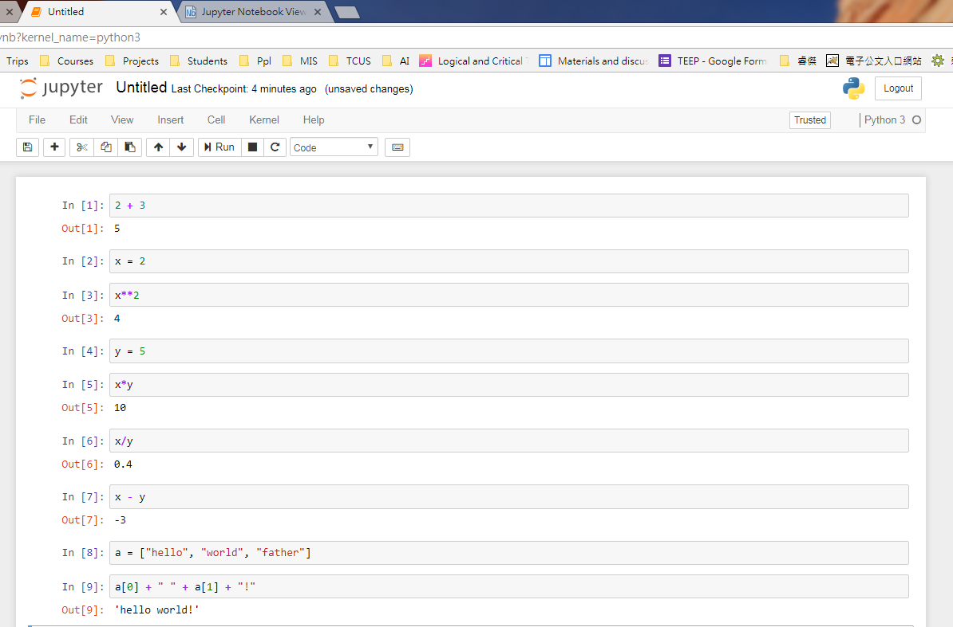

Slide 58
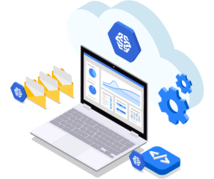

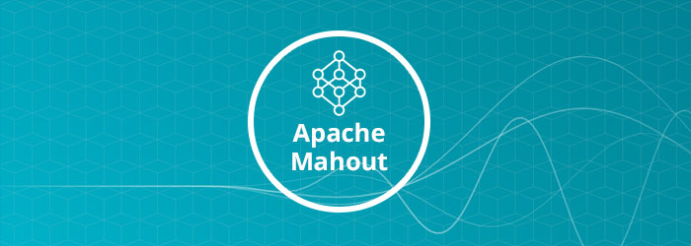

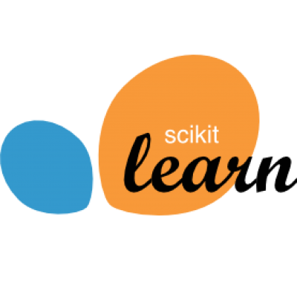
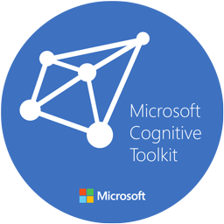




Deep learning frameworks
Google Cloud ML Engine
Apple’s Core ML
https://www.cubix.co/blog/best-machine-learning-frameworks-in-2020/

Slide 59
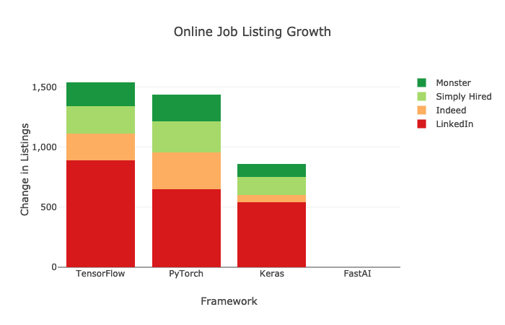
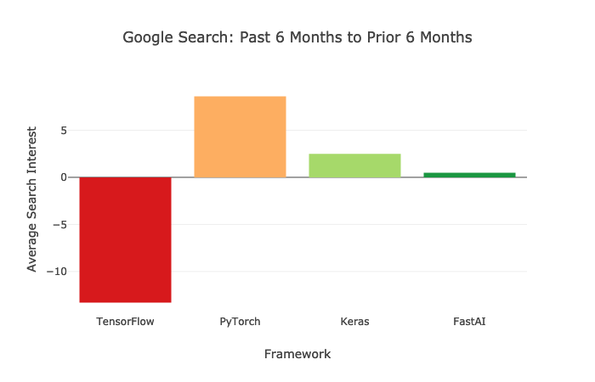
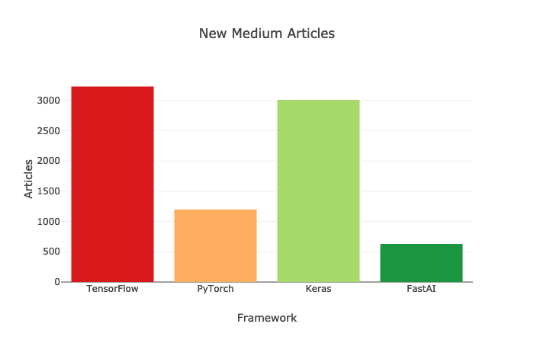
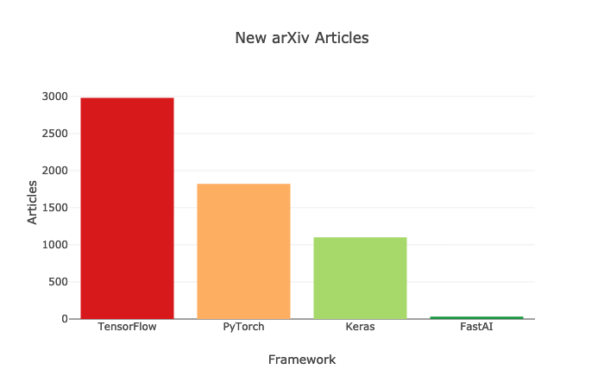
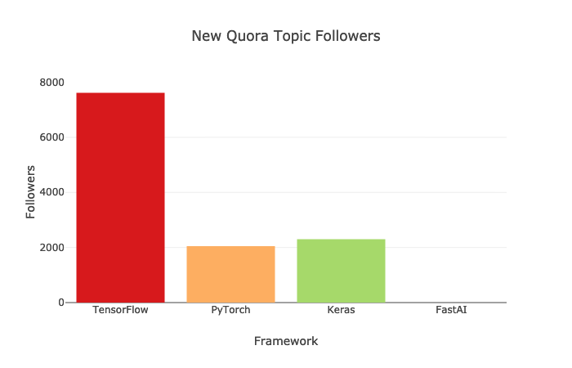
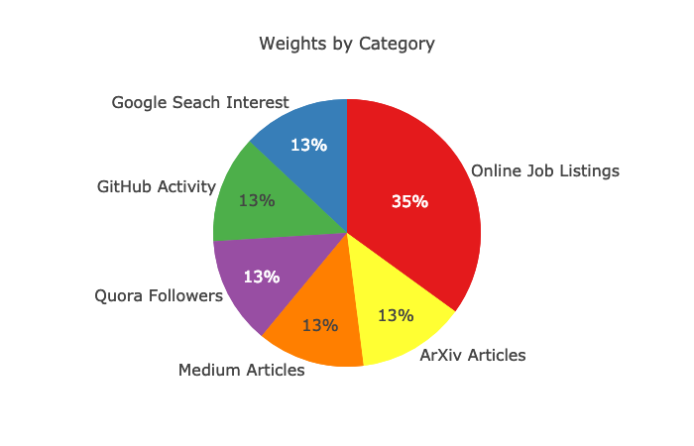
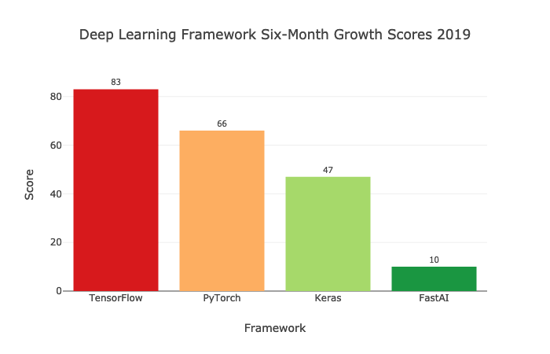
Deep Learning Frameworks (as of 2020/3)
https://towardsdatascience.com/which-deep-learning-framework-is-growing-fastest-3f77f14aa318

Slide 60
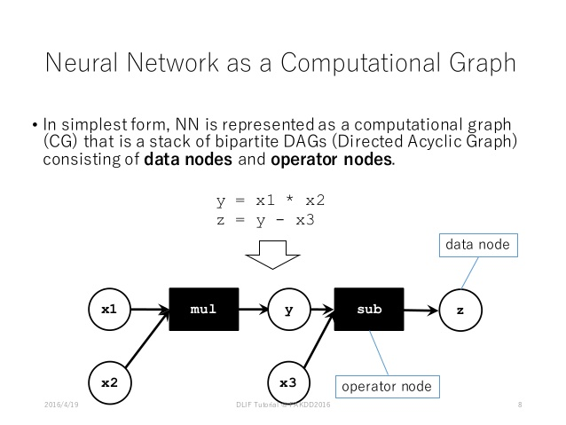
Deep learning frameworks
Easily build big computational graphs
Easily compute gradients in computational graphs
Run it all efficiently on GPU
https://en.wikipedia.org/wiki/Comparison_of_deep_learning_software
http://cs231n.stanford.edu/slides/2017/cs231n_2017_lecture8.pdf
https://towardsdatascience.com/a-survey-of-deep-learning-frameworks-43b88b11af34

Slide 61
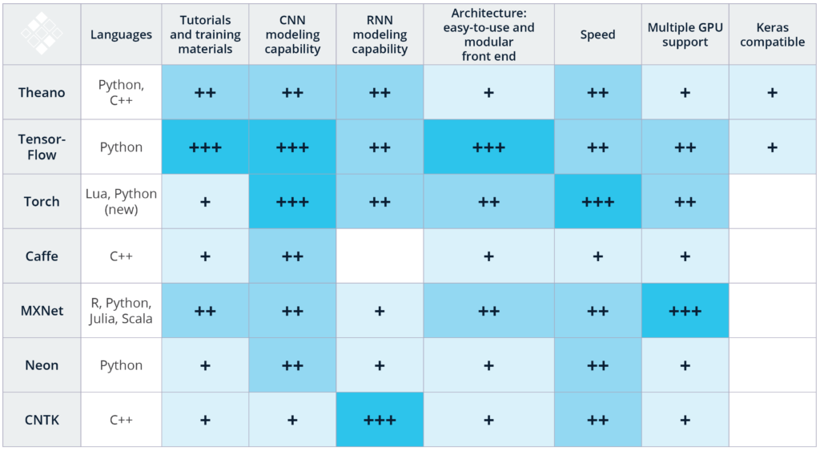
Comparisons in modeling capabilities
https://www.kdnuggets.com/2017/03/getting-started-deep-learning.html

Slide 62
Comparisons in code

Slide 63
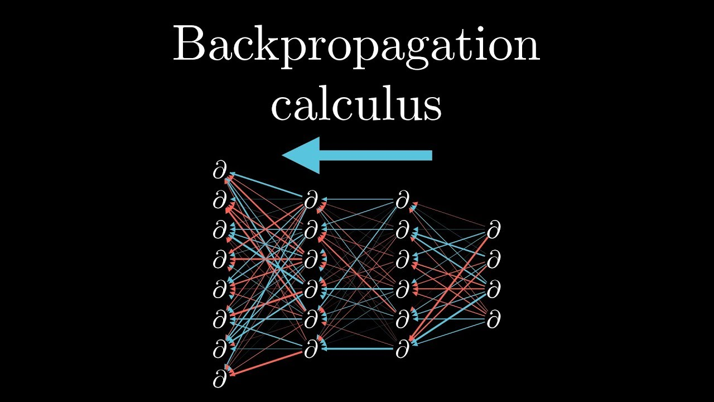
Calculus
Partial derivatives
Chain rule
https://www.youtube.com/watch?v=tIeHLnjs5U8

Slide 64
What we learnt?
Bonus points for correct and accurate answers to the following questions:
What is machine learning?
What is the difference between machine and deep learning?
Can CNN and RNN be combined into one neural network architecture? If yes, for what kind of applications?
Given the following Python code:
>>> def f4(x,a=1):
... return a*x**2
...
>>>
What is the value of f4(2)?
What is the value of f4(2, 2)?

Slide 65
What to do now?
Install Python
Install Jupyter
Play with Jupyter Notebooks and Python

